Slide 1
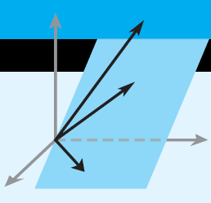
Elementary Linear Algebra
Euclidean Vector Spaces
Chapter 3
Notes:
*

Slide 2
Material in this chapter
3.1 Vectors in 2-Space, 3-Space,
and n-Space
3.2 Norm, Dot Product, and Distance in R^{n}
3.3 Orthogonality
3.4 The Geometry of Linear Systems
3.5 Cross Product
Notes:
*

Slide 4
Vectors
Addition of vectors by the
parallelogram or triangle rules
Notes:
*

Slide 5
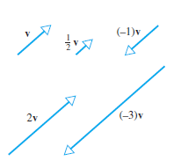
Subtraction:
Scalar
Multiplication:
Notes:
*

Slide 6
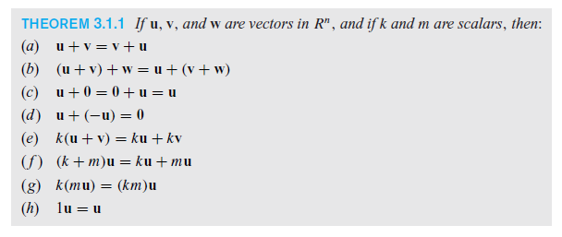
Properties of Vectors
Notes:
*

Slide 7
Norm, Dot Product, and Distance in R^{n}
Norm:
Unit Vectors:
Notes:
*

Slide 8
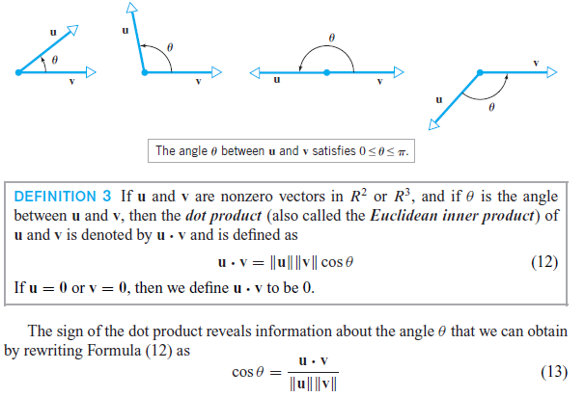
The Dot Product
Notes:
*

Slide 9
The Dot Product
Notes:
*

Slide 10
Properties of the Dot Product
Notes:
*

Slide 11
Cauchy-Schwarz Inequality
Notes:
*

Slide 12
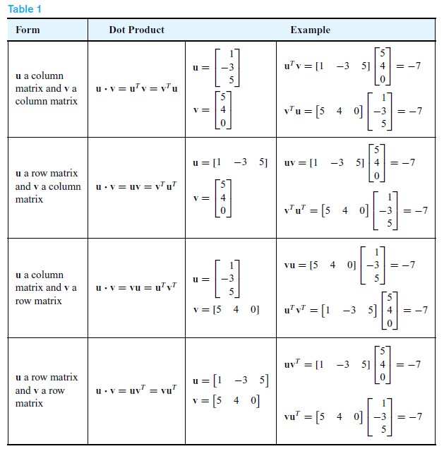
Dot Products and Matrices
Notes:
*

Slide 13
Section 3.3 Orthogonality
Notes:
*

Slide 14
Orthogonal Projections
Notes:
*

Slide 15
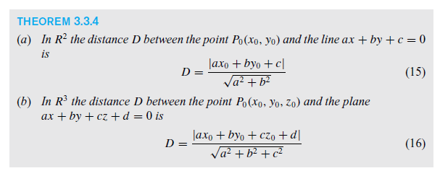
Point-line and point-plane Distance formulas
Notes:
*

Slide 16
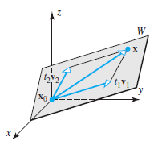
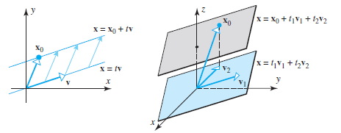
The Geometry of Linear Systems
Notes:
*

Slide 17
Notes:
*

Slide 18
Cross Product
Notes:
*

Slide 19
Cross Products and Dot Products
Notes:
*

Slide 20
Properties of Cross Product
Notes:
*

Slide 21
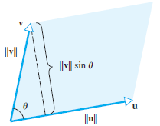
Geometry of the Cross Product
Notes:
*

